Slide 1

DISASTER-RESILIENT COMMUNICATION NETWORK USING MESH TOPOLOGY
BY
TEAM:SKYNET

Slide 2

TABLE OF CONTENT
1.
TEAM ORGANIZATION
2.
INTRODUCTION
3.
PROBLEM STATEMENT
4.
NETWORK DESIGN
5.
AODV ROUTING PROTOCOL
6.
SIMULATION SETUP
7.
RESULTS AND ANALYSIS
8.
APPLICATIONS
9.
CONCLUSION
10.
FUTURE WORK

Slide 3
TEAM ORGANIZATION
TEAM MEMBERS
SUPERVISOR
Salma Sadia Ani(C213241)
Joinab Binte Siraj Asif(C213248)
Mahiah Kulsum(C213260)
Fatima Ibrahim Chowdhuryi(C213268)
Abdullahil Kafi
Assistant Professor
Department of CSE, IIUC

Slide 4


INTRODUCTION
Objective:
Design and simulate a wireless communication network for disaster-resilient application
Ensure communication continuity using AODV routing protocol
using dynamic ad-hoc routing protocols
Tools Used: OMNeT++, INET Framework
Key Features:
Dynamic node movement
Energy-efficient operation
Ad-hoc routing (AODV)

Slide 5


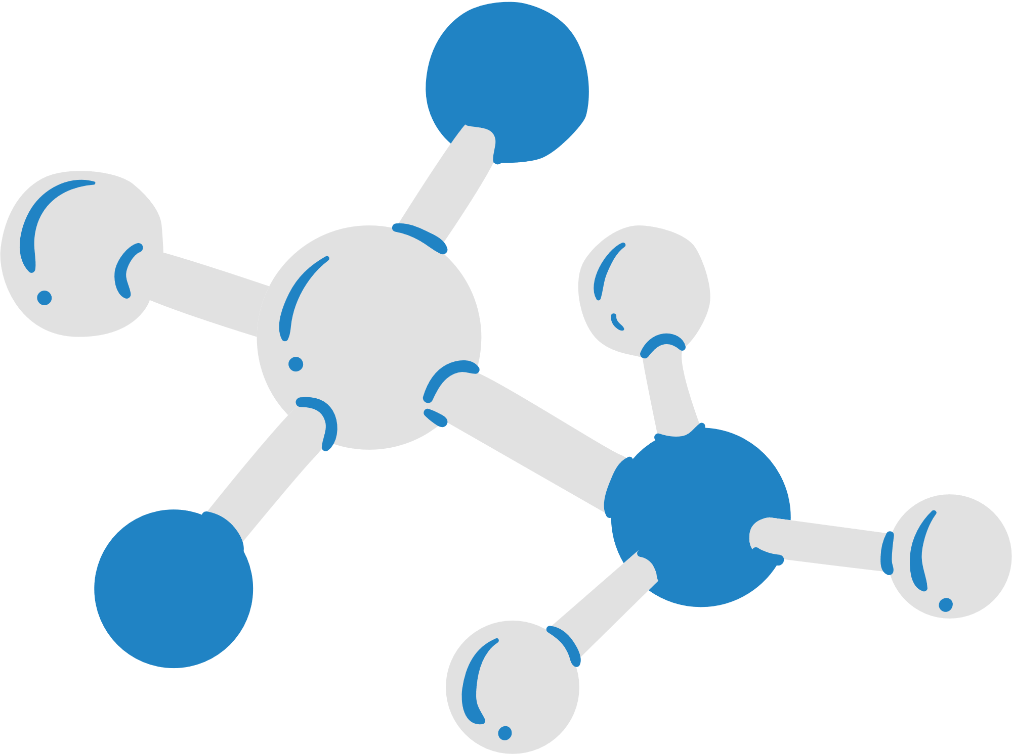
PROBLEM STATEMENT
Challenges During Disasters:
In disaster scenarios, wireless networks face issues such as high mobility of nodes, interference, and frequent network disconnections, leading to unreliable communication and poor performance in terms of throughput, delay, and energy consumption.
Solution:
Implementing a resilient communication network with adaptive routing (e.g., AODV), interference management, and energy-efficient protocols can ensure stable connectivity, even in dynamic and challenging environments, facilitating efficient communication during disasters.

Slide 6
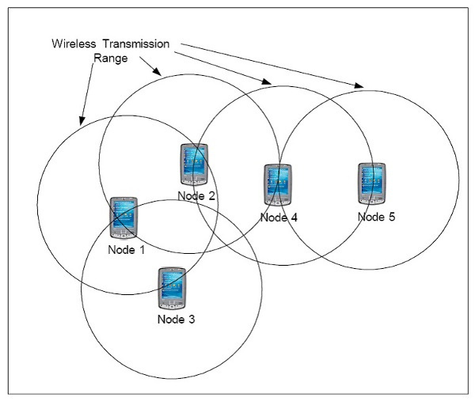
NETWORK DESIGN
WirelessA Network:
Two-host communication setup
Basic UDP data transmission
WirelessB Network:
Multi-host setup with routers (hostR1, hostR2, hostR3)
Linear Mobility and AODV Routing Protocol

Slide 7
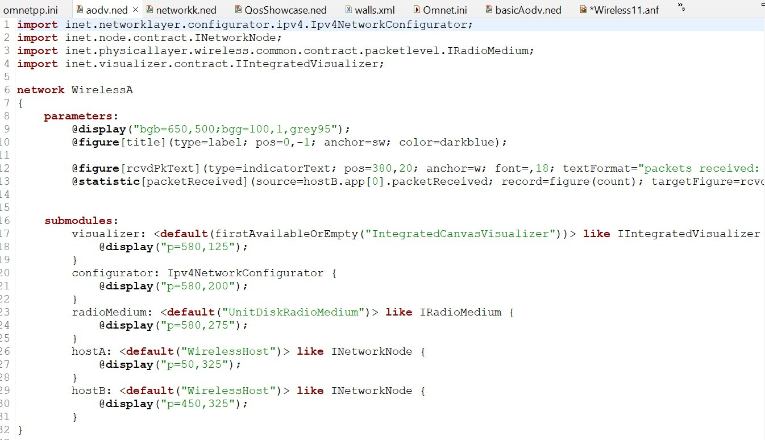
NETWORK DESIGN

Slide 8
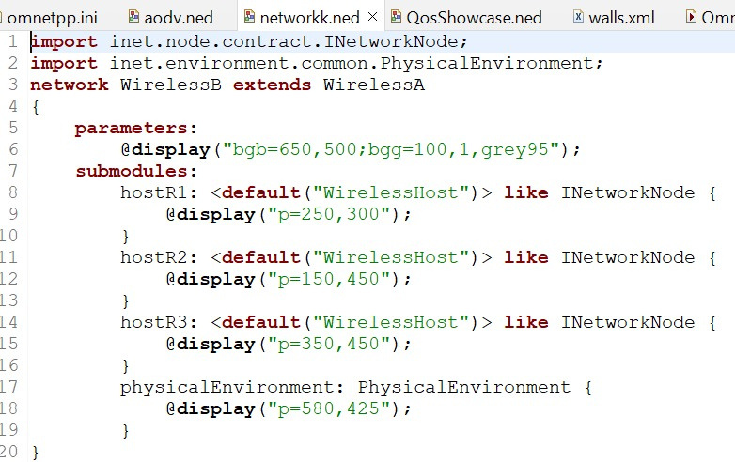
NETWORK DESIGN

Slide 9
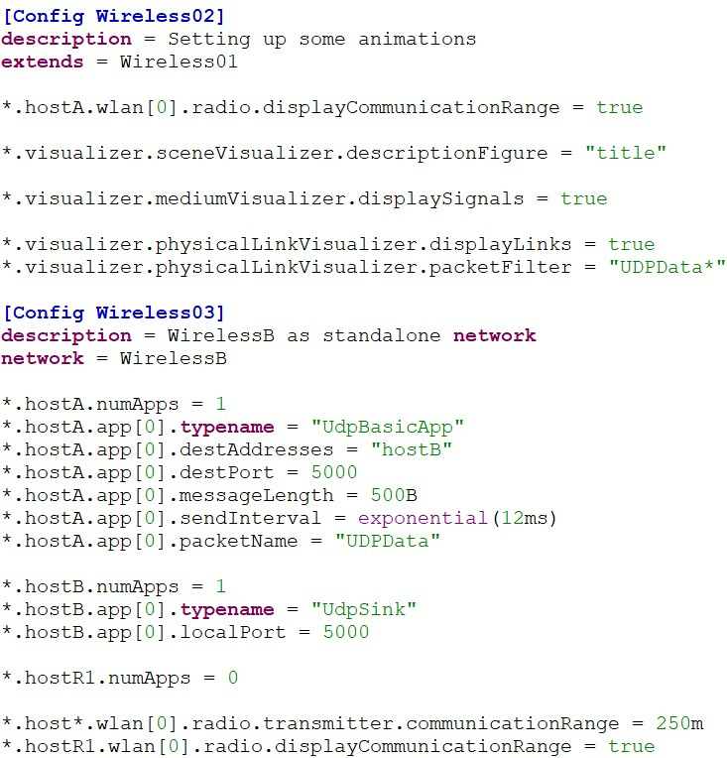
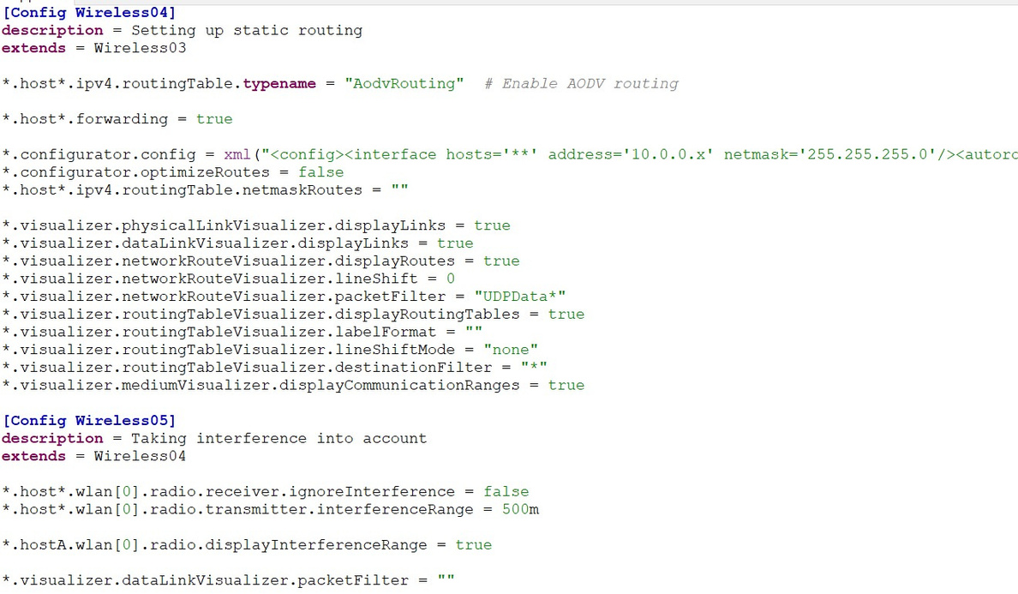
NETWORK DESIGN

Slide 10
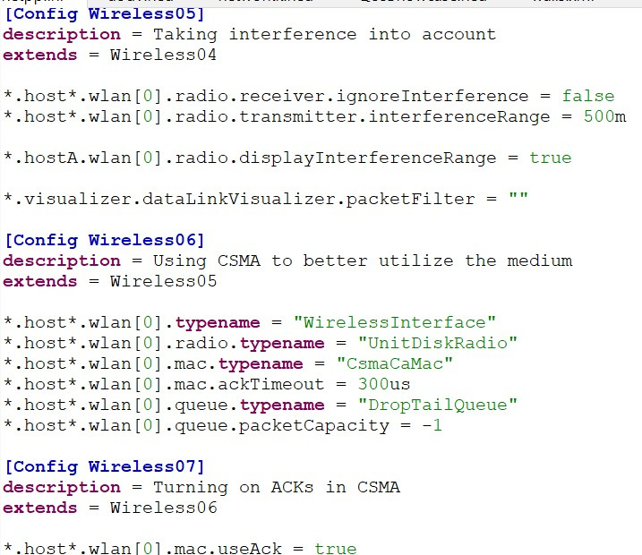
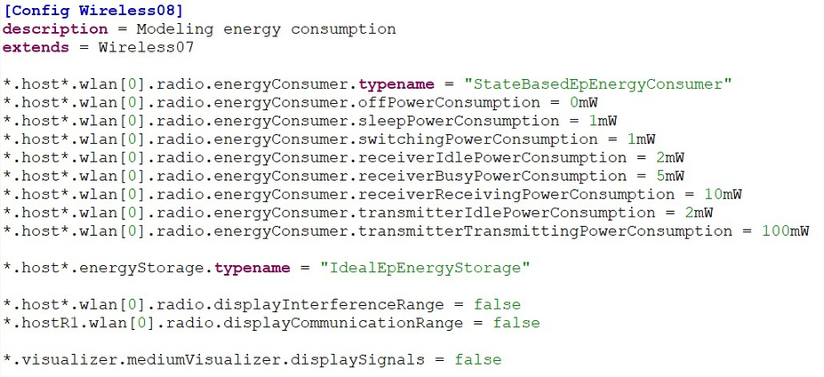
NETWORK DESIGN

Slide 11
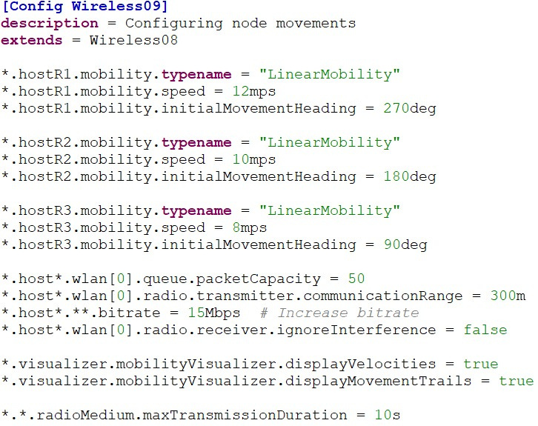
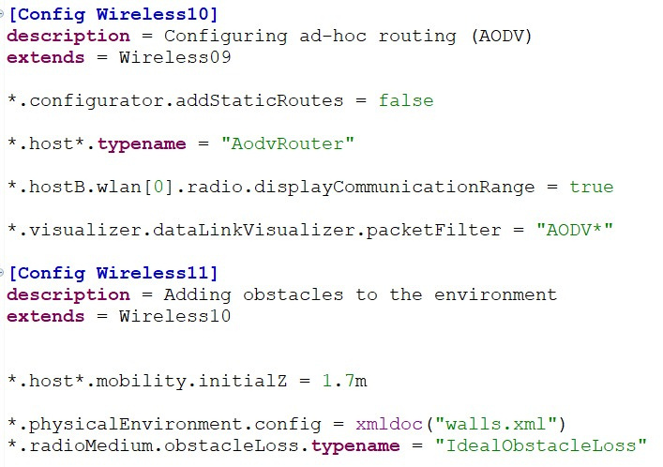
NETWORK DESIGN

Slide 12



AODV ROUTING PROTOCOL
What is AODV?
A reactive routing protocol designed for mobile ad hoc networks
Routes are established only when needed, reducing overhead
How it Helps in Disaster Networks:
On-demand route discovery
Dynamic adjustment to changes in the network

Slide 13



SIMULATION SETUP
Tool Used:OMNeT++ with INET Framework
Network Parameters:
Packet delivery simulation between hostA and hostB
Energy consumption modeling for nodes
Linear mobility for nodes R1, R2, and R3
Scenarios Simulated:
Communication Range and Interference
Mobility and Routing Adaptation
Energy Efficiency

Slide 14
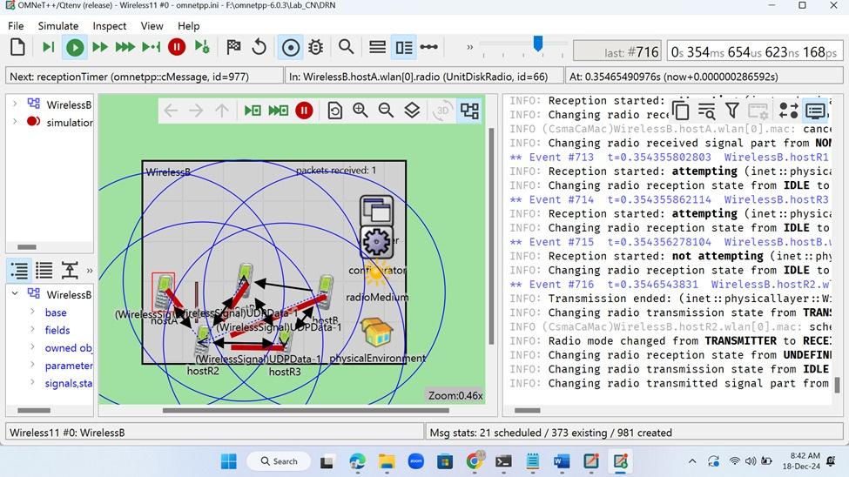
RESULTS AND ANALYSIS

Slide 15
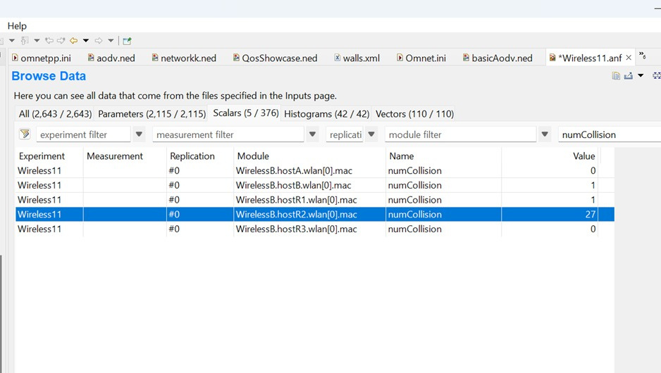
RESULTS AND ANALYSIS

Slide 16
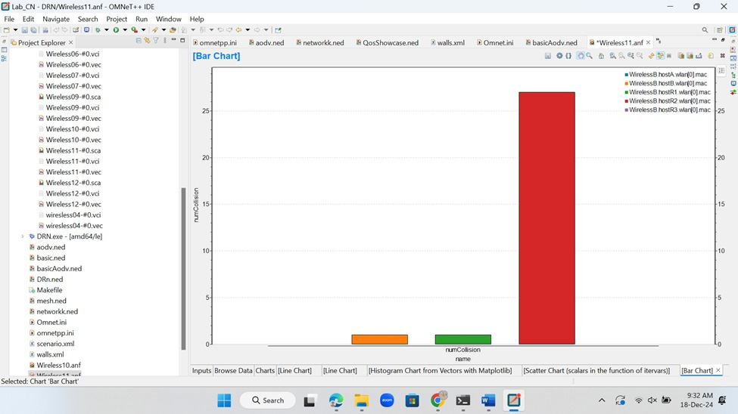
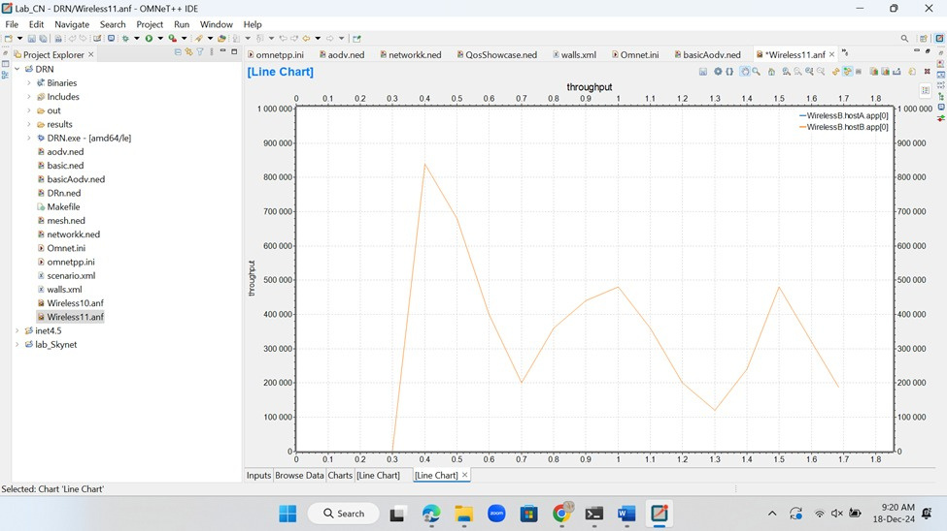
RESULTS AND ANALYSIS

Slide 17
APPLICATIONS
Emergency Communication:
For first responders and relief teams
Post-Disaster Recovery:
Quickly re-establishing communication in disaster-stricken areas
Remote Areas:
Providing connectivity where traditional networks are not feasible
Rural Connectivity:
Deploy networks in remote areas without existing infrastructure

Slide 18
CONCLUSION
Summary:
Developed a simulation-based disaster-resilient network using AODV routing in OMNeT++.
Demonstrated the reliability, scalability, and energy efficiency of mesh topologies
Impact:
Provides a scalable and adaptable communication solution for disaster-prone regions

Slide 19
FUTURE WORK
Optimising AODV: Improve performance in extreme network conditions (high mobility, interference)
Integration with Other Technologies:Integration with satellite communication or drone-based networks
Field Testing: Deploy in real-world disaster scenarios to validate the simulation results
Real-World Deployment:Validate the simulation in practical disaster recovery scenarios

Slide 20
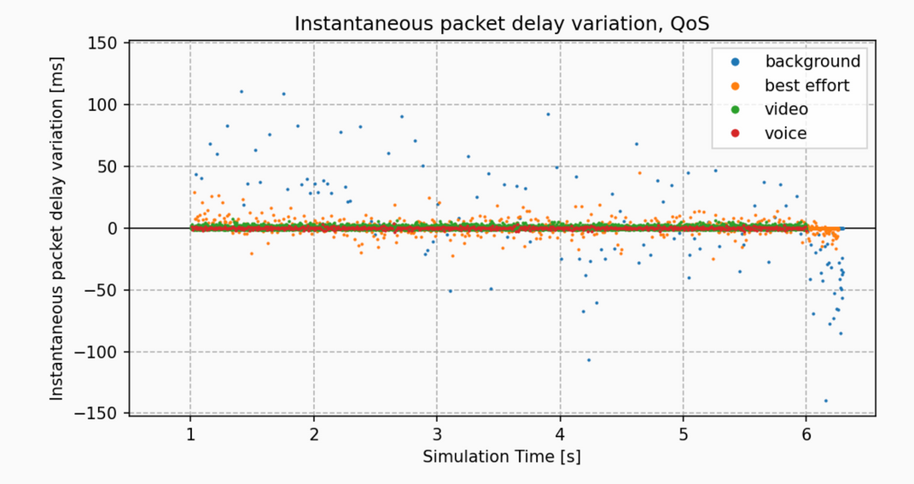
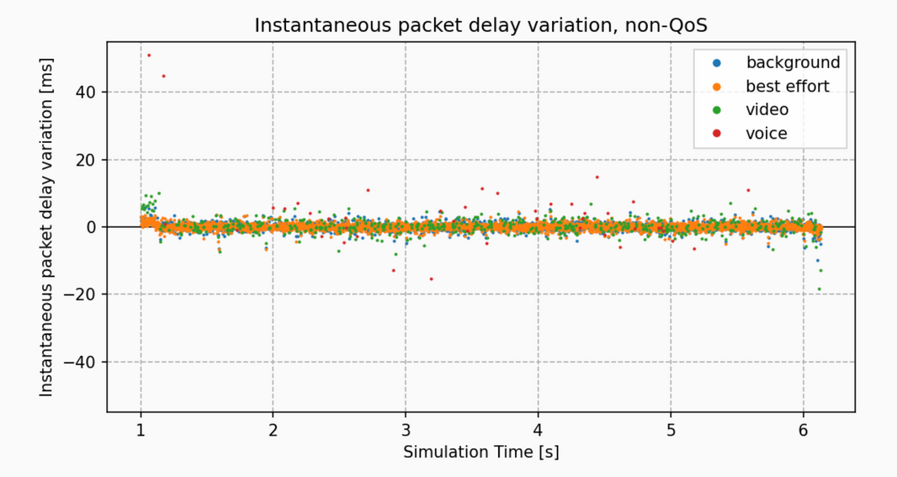
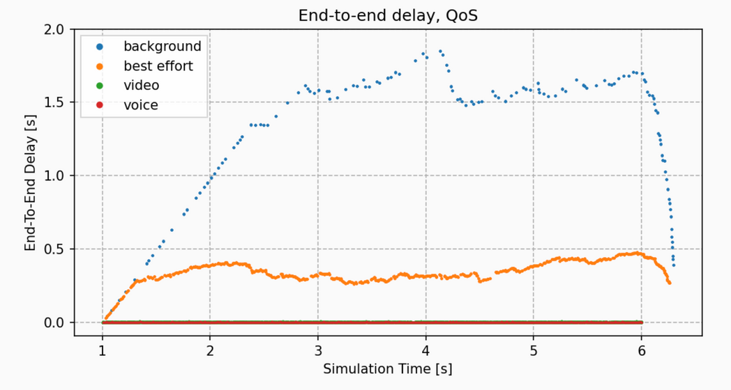
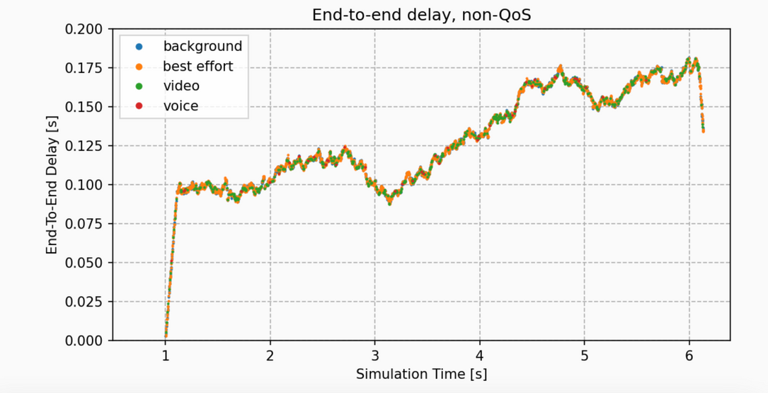
FUTURE WORK

Slide 21
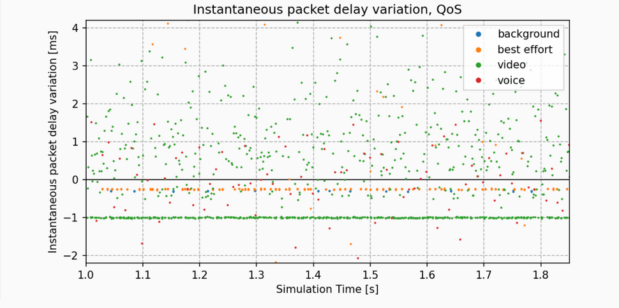
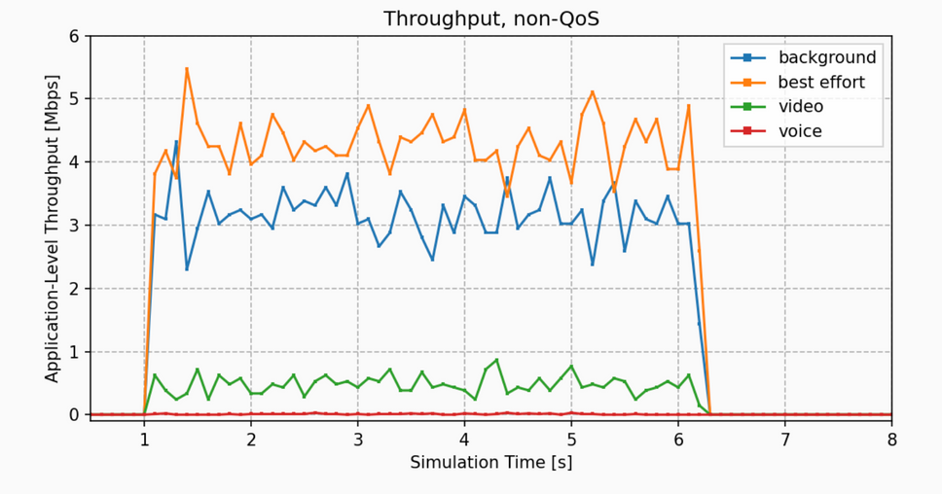
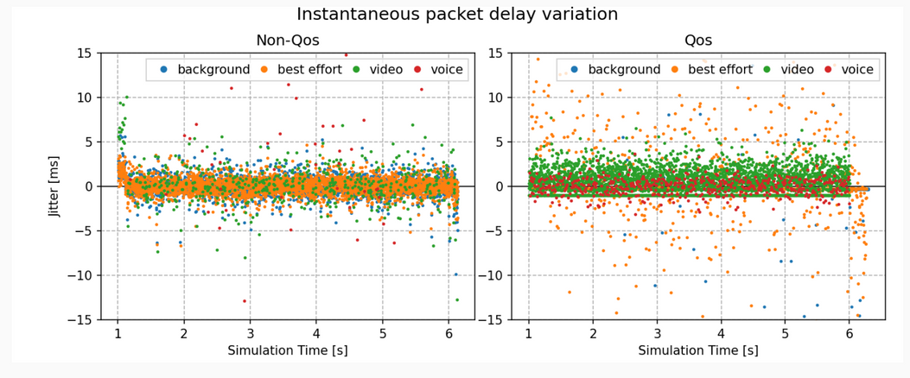
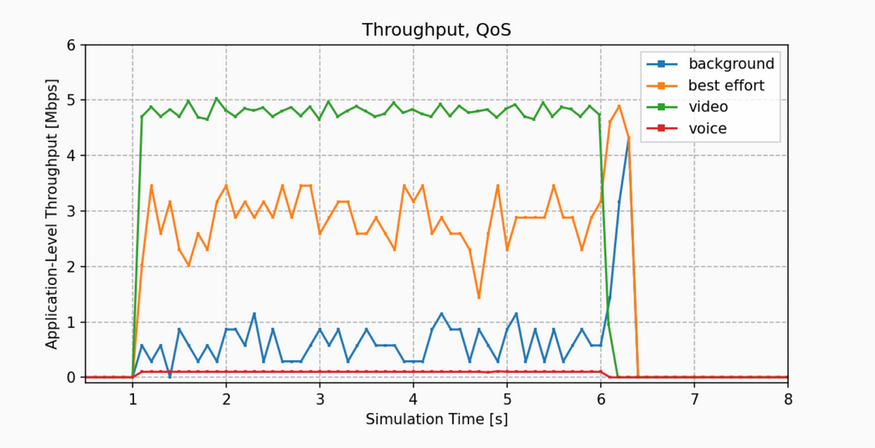
FUTURE WORK

Slide 22

THANK YOU
From Team Skynet

